Slide 1
AuE 835: Automotive Electronics
Project 1: AUTONOMOUS VEHICLE
Project 2: AUTONOMOUS BOAT
Group 17
Akil Patheria
Kaushik Tilve
Sanket Bachuwar
Yong He

Slide 2
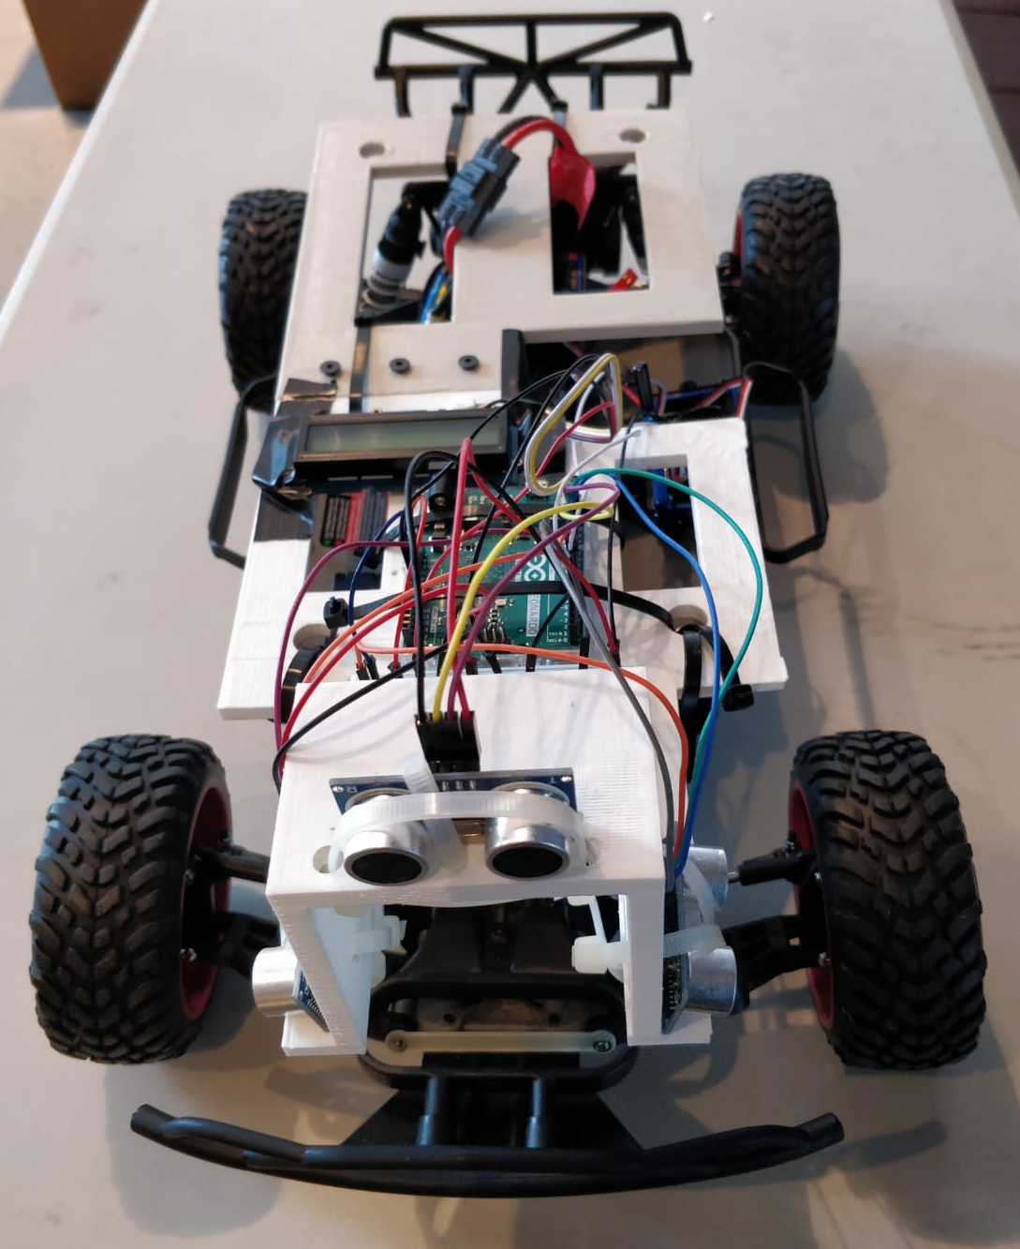
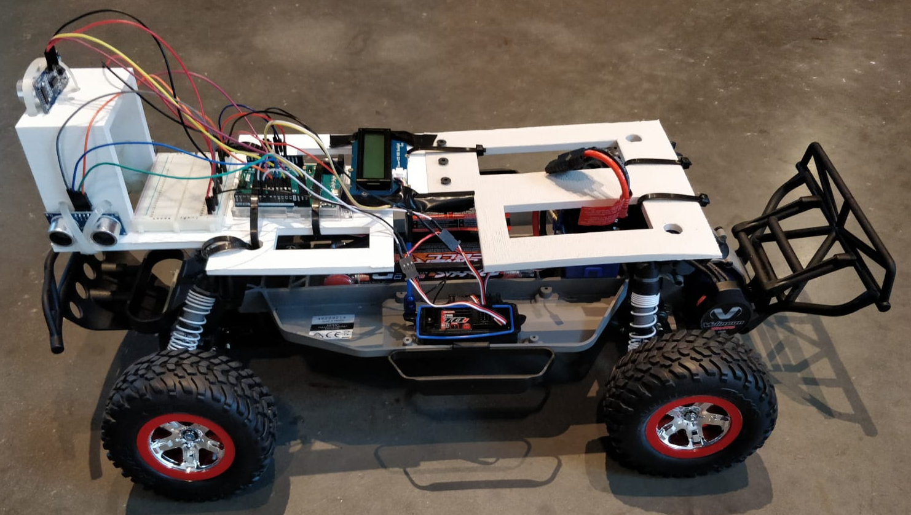
Project 1
Small-scale autonomous vehicle for adaptive cruise control and lane keeping

Slide 3
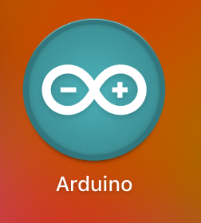
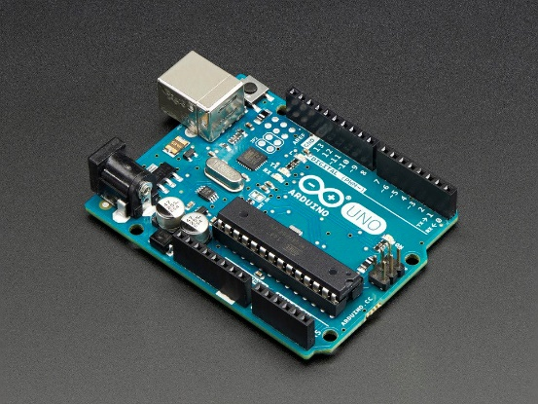
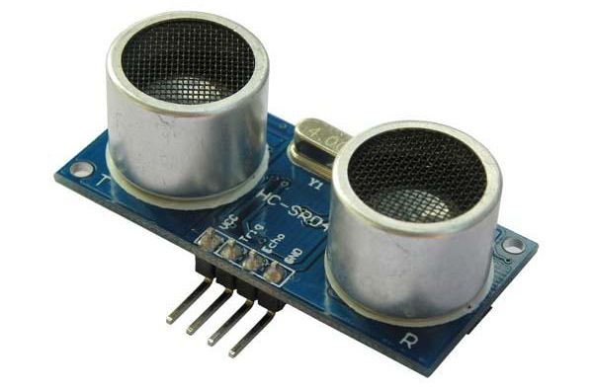
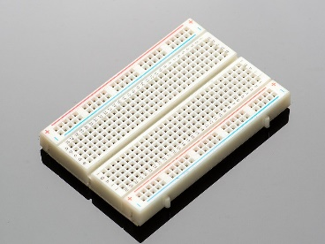
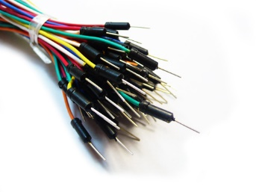
Hardware and Resources

Slide 4
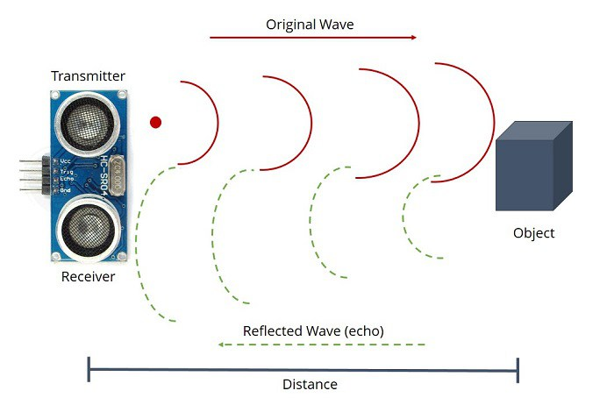
1.1 Signal Processing
The aim of this task was to employ signal processing techniques in order to obtain accurate distance values from an ultrasonic sensor
The tasks that had to be performed were:
Sampling the Signal at a frequency of 10 Hz
Filtering out the noise by implementing a Kalman Filter
Calibrating the sensor data to obtain accurate values

Slide 5
Test Setup ? Code Logic ? Method ? Equations ?

Slide 6
Raw Data
The Sampling Frequency was set as 10 Hz
Multiple readings were recorded for all the three sensors at various distances up to 1.5 m
These readings were then imported into EXCEL and used to calculated the Measurement Co-variance R which are as follows:
R(Sensor 1):
R(Sensor 2):
R(Sensor 3):

Slide 7
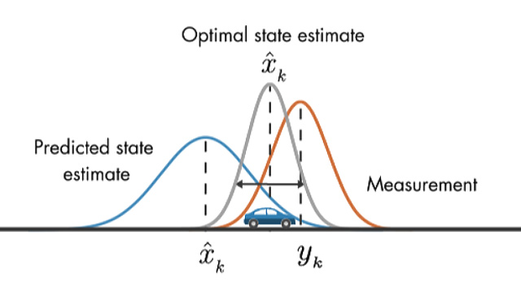
Kalman Filter Design and Implementation
Kalman filter
Prediction:
Correction:

Slide 8
Plots ? Graphs ?

Slide 9
Calibration
The filtered data was calibrated using piecewise linear regression.
The linear regression was of the form “Y = a*X + b”
The variables “a” and “b” were calculated for various ranges and implemented

Slide 10
Challenges
Designing the test setup such that minimum error is induced between the readings of various sensors at all the multiple distances
Selecting the Kalman filter Parameters such that convergence is achieved within 10 seconds
Calibrating the sensor such that it gave accurate values throughout the range
Solutions
The test setup included a fixed base onto which the sensors were mounted & the distances to be measured were marked on a flat surface
Piecewise Linear regression was used to obtain accurate readings throughout the 1.5 m range.

Slide 11
1.2 Run Down the Hill
To design a control system for an Autonomous vehicle that can navigate through the test track while performing the following:
Adaptive Cruise Control: The vehicle should come to a halt a distance of 30 cm from any obstacle in its path.
Autonomous Lane Keeping: The vehicle should be able to steer appropriately such that it stays within the track limits.

Slide 12
Mounting on RC vehicle
3-D Printed plate was used as a base for mounting electronics
The ultrasonic sensors were fixed to the base with integrated supports in the base plate
A power bank was used to power the electronics and to provide extra weight for traction.
Insert image and label everything

Slide 13
Filtering
Control Model design: adaptive cruise control
A Proportional - Integrator - Derivative (PID) controller in tandem with conditional logic was employed to control the speed and direction of motion of the vehicle based on the sensor readings.
The controller was tuned using manual tuning which was initially displayed using the Serial Plotter & subsequently was tested on the vehicle.
The final values for the controller input were
Kp=
Ki=
kd=

Slide 14
Control Model design: autonomous lane keeping
For steering the vehicle one sensor was mounted on each side.
Data from both sensors was filtered using …. & calibrated using Piecewise Linear Regression.
The left and right distance values were used to control the direction and magnitude of the steering input.

Slide 15
Challenges
Position of Sensor Mounts
Appropriately Tuning the PID Controller
Steering controls based on differential sensor setup
Getting the car to stop 30 cm before an obstacle and reverse if the obstacle is closer
Not Braking in time and hitting the wall
After fusion of velocity and steering, the motion of the vehicle was erratic. Leading to missing a lot of checkpoints.
Solutions
Side sensors were mounted close to the front of the vehicle to enable better sensing of the changing track layout.
A correction factor was added to the code to account for the relative offset of the two side sensors.
The PID controller was tuned initially using the Serial Plotter & then was verified on the vehicle
We had to use a steering command of …. in order to get the vehicle to go straight.

Slide 16
Results
Autonomous vehicle stopped at a distance of 30 cm ahead of obstacle.
No oscillations were observed after stopping.
Vehicle did not hit the obstacle before stopping.
Vehicle passed all the check points.
The given distance was covered in 17 seconds.

Slide 17
Learnings
The Syntax used to code an Arduino
Practical application of Kalman filter
Testing and Calibration techniques of Ultrasonic Sensors
A gist of the possible challenges and solutions in design of an autonomous vehicle
Design of an electro-mechanical system & the challenges that it poses
Design of a PID controller & manual tuning of its parameters

Slide 18
Limitations
Slower convergence using kalman filter.
Convergence time should be within 10 seconds.
Results affected by human error.

Slide 19
Explain PID tuning (how) and give final values
Insert test video
Insert code used ?
Human tracking ?
LCD ?
Future Plans ?

Slide 20
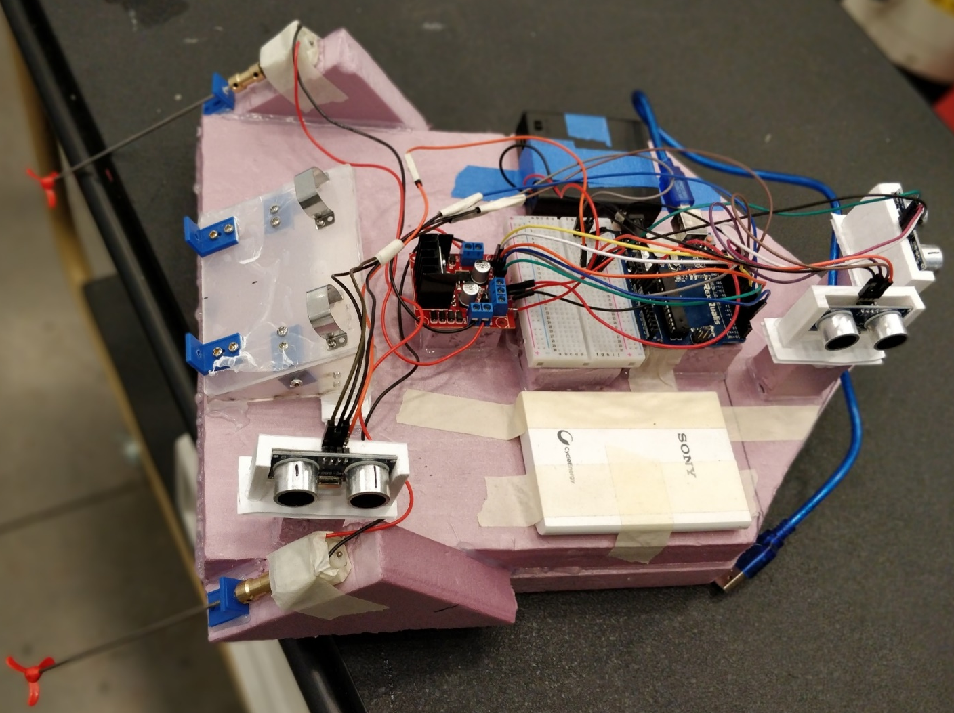
Project 2
Design of a small scale autonomous boat for ocean conservation

Slide 21
Test Setup ? Code Logic ? Method ? Equations ?
Problem Statement: Design an Autonomous Trash Collecting Boat to curb the problem of micro-plastic pollution in the Oceans around the world.

Slide 22
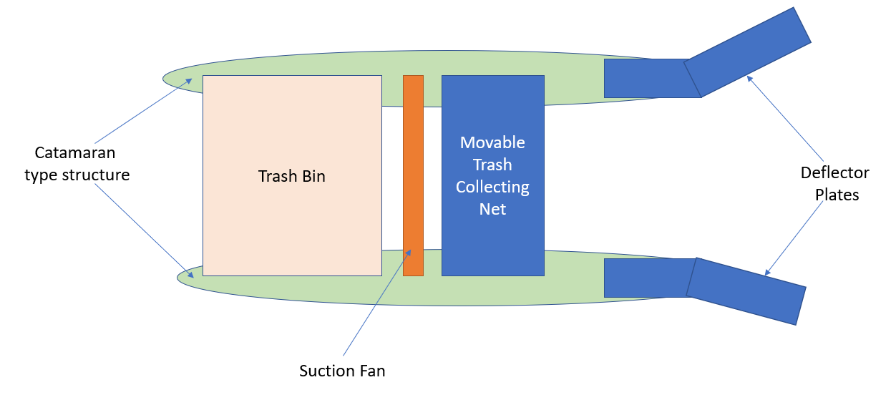
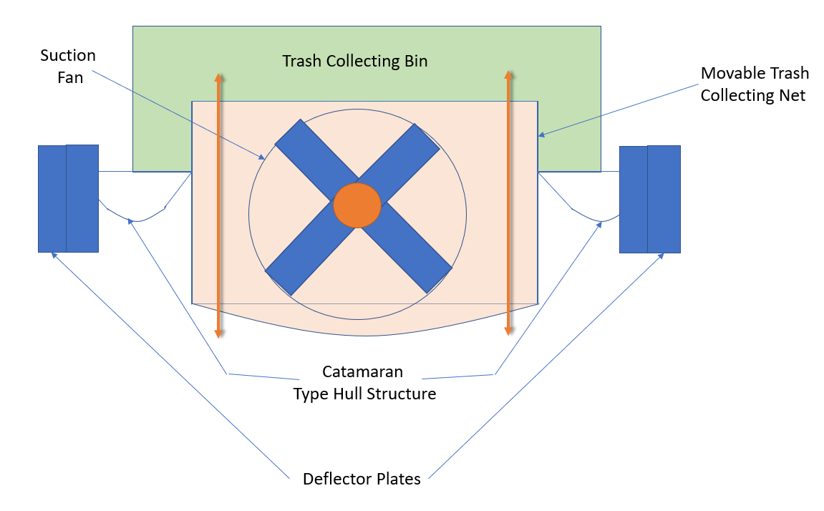
Concept Design

Slide 23
Hardware

Slide 24
Design of the Boat Body & Hardware Setup:
Material Selection:
The only criteria were to select a material that was one, waterproof and two, could be bent to a certain extent to form the shape of the hull.
We explored a few materials such as corrugated plastic sheet and wood but then finally chose a foam board sheet which had good strength, stability and was also waterproof.
Boat exterior Design:
Initially to decide the size of the boat, we determined a rough layout displaying the placement of the various components.
We decided to design the hull in a curved manner (initial) in order to reduce the drag, improve stability in wavy waters & improve the steering characteristics of the boat.
But final design (challenges of stability and roll)
The foam were cut according to initial drawings & then attached together using a glue gun to form the physical shape of the boat

Slide 25
Interior design,
first decided the placement & inclination of the propeller shafts so that they are sufficiently submerged in water in order to provide thrust to the boat.
Additionally, the shafts had to be sufficiently wide apart so as to generate a steering moment which is capable of turning the boat.
Corresponding to the inclination & position of the shafts we fixed the motors at the same inclination on a mount near the rear of the boat.
In order to place the rest of the components we had to create a deck like structure after which we could place the Motor controller, Arduino & the battery packs to avoid water damage
mounting the sensors, we used 3D printed brackets to mount the front & the side sensors.
A breadboard was also placed on the top deck in order to aid the connection of the Ultrasonic Sensors with the Arduino.

Slide 26
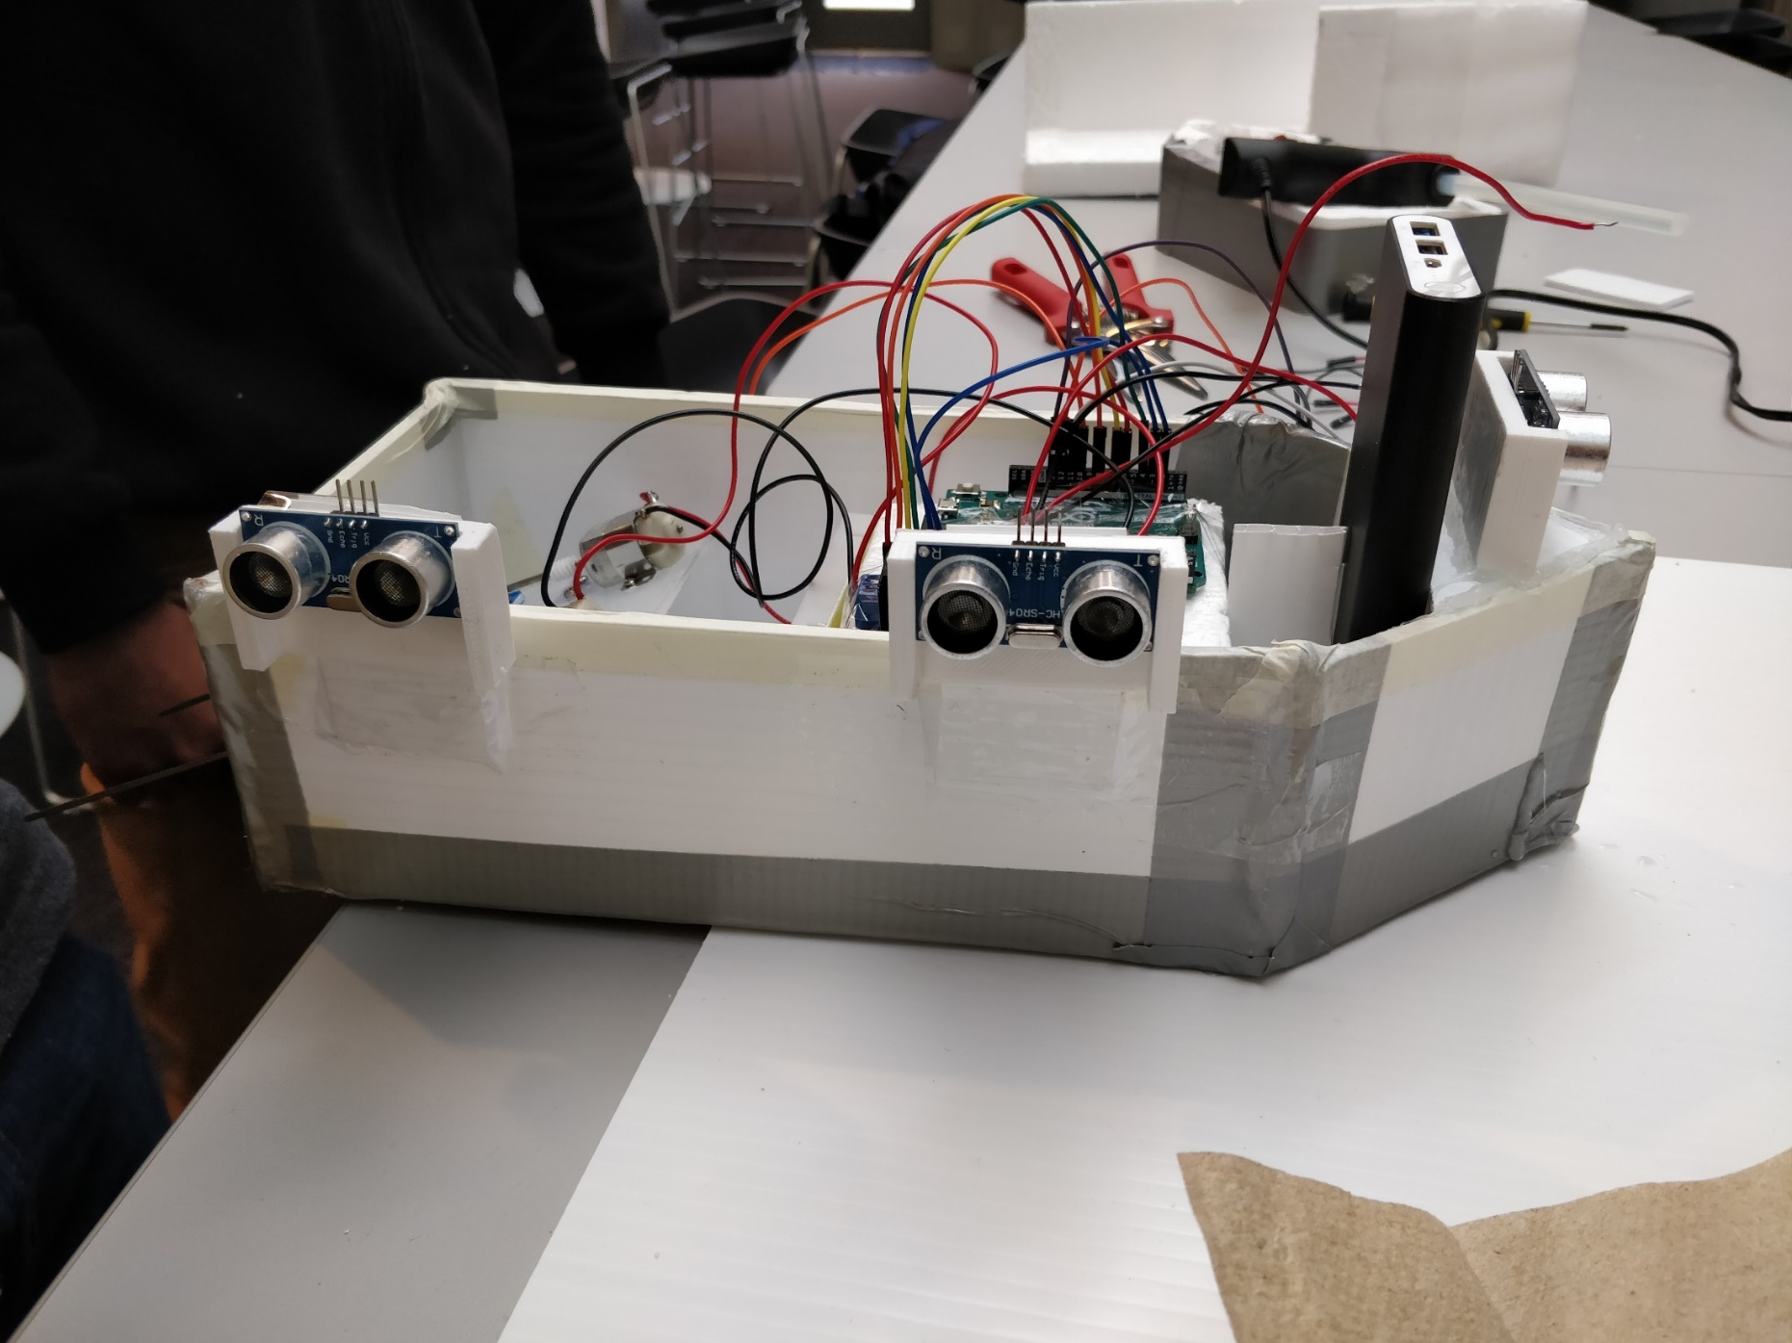
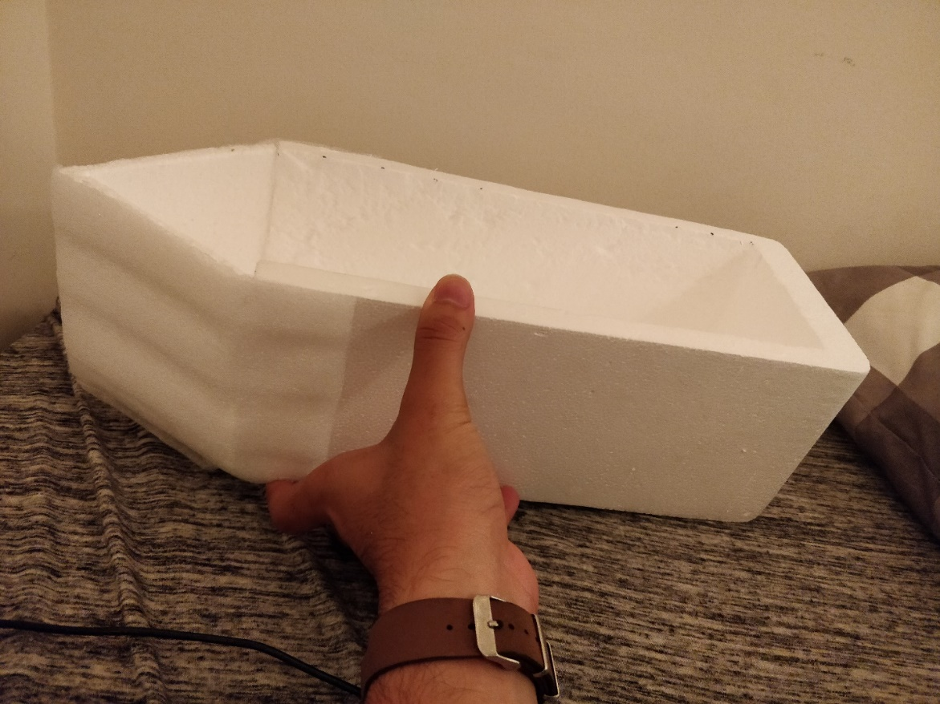
Preliminary Implementation of an Autonomous Boat

Slide 27
The enable & logic pins on the controller are connected to the PWM pins on the digital input side of the Arduino Uno. These will be used to transmit the logic to control the speed & direction of rotation of the two motors.
Two separate power sources have been used for the Arduino Uno (5V power source) & the Motor Controller (6V power source).
The two motors are connected in to their respective ports on the motor controller in the opposite sense. This is because the propellers have been designed and mounted in such a way that for the boat to move forward they must rotate in the same direction (clockwise)
The Trigger & Echo pins of the Ultrasonic Sensors are connected to their respective ports on the digital side of the Arduino while their Vcc & Ground pins are connected to the Arduino through the breadboard.

Slide 28
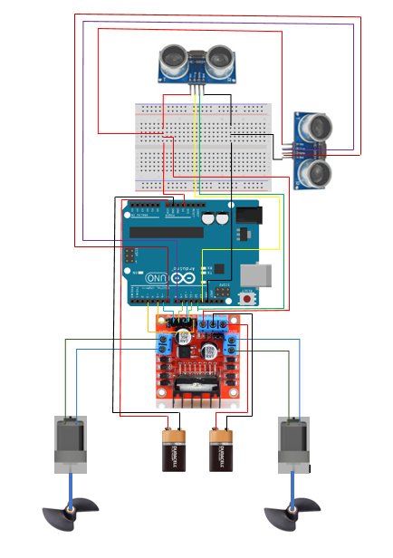
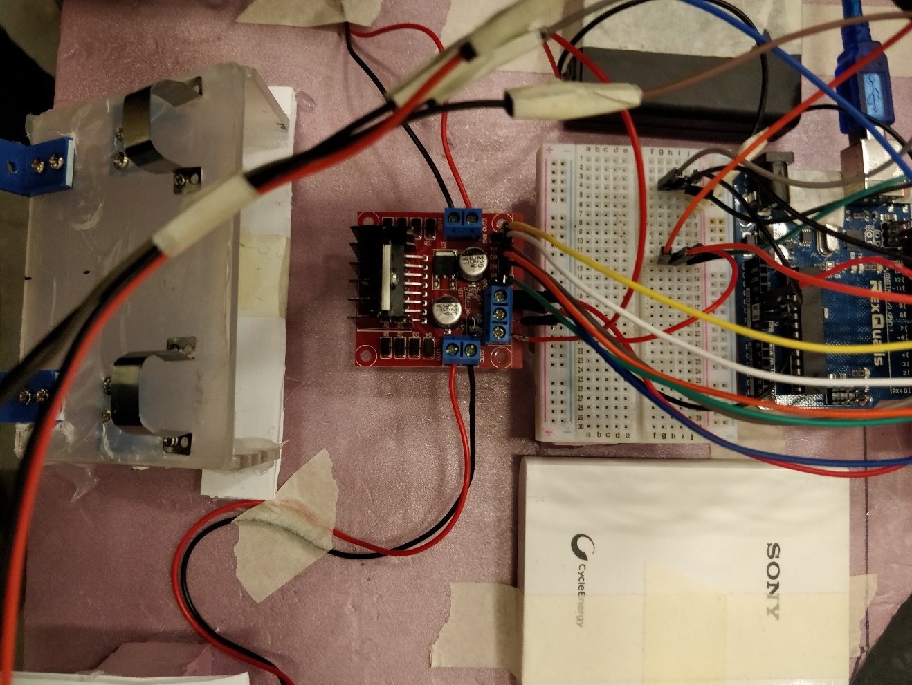

Slide 29
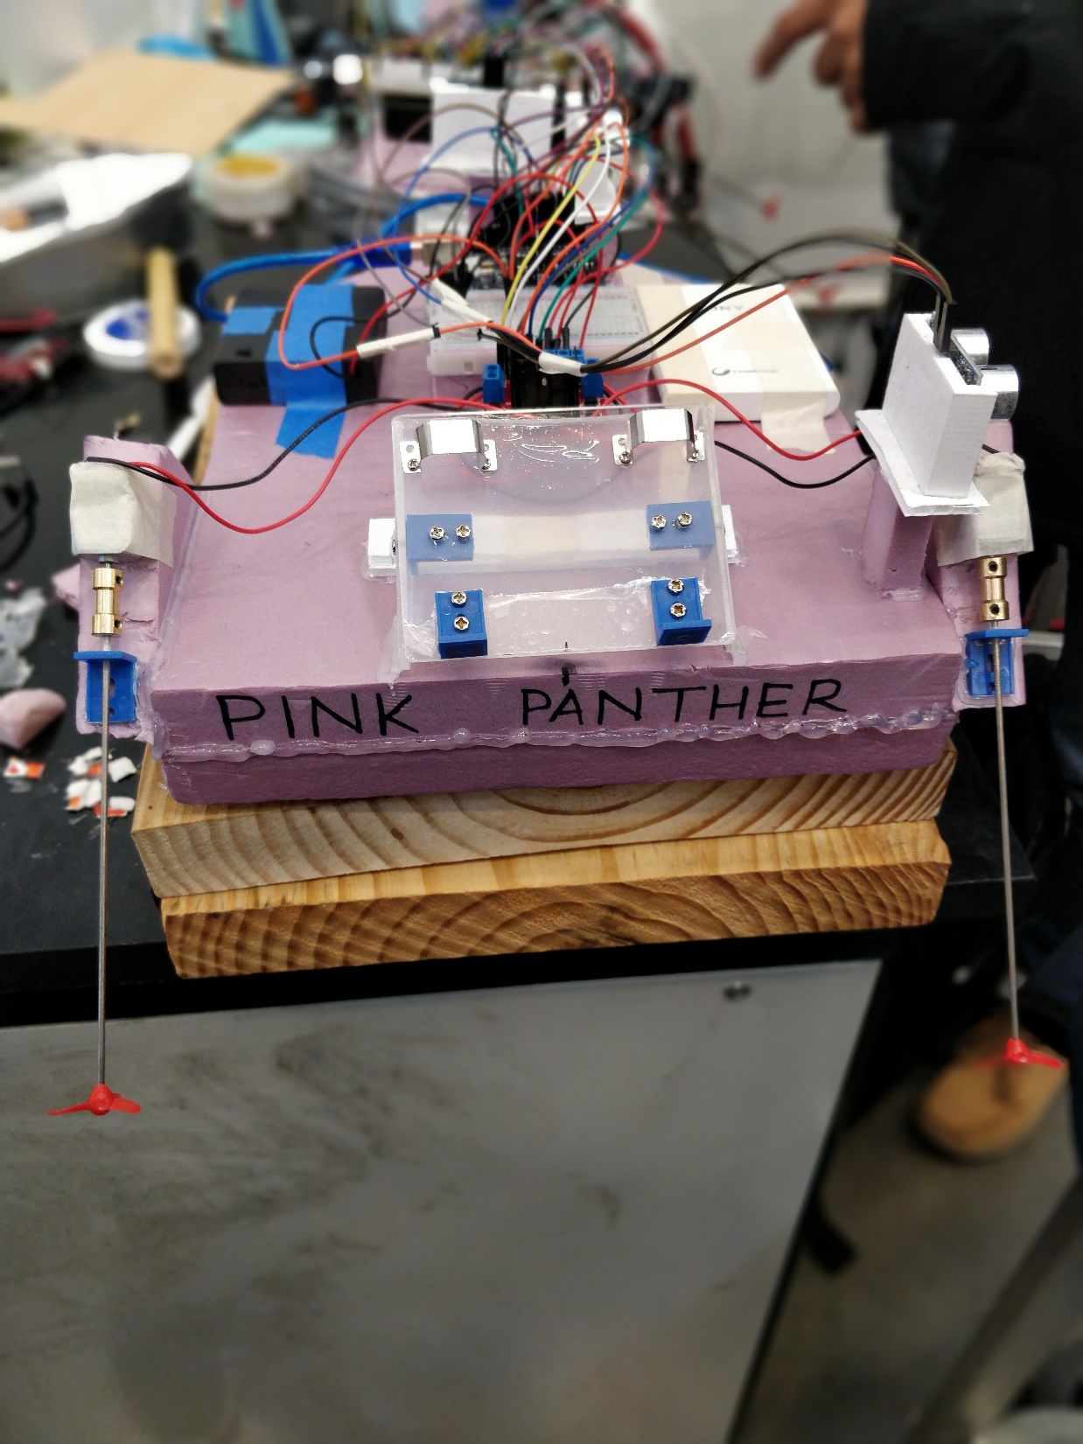
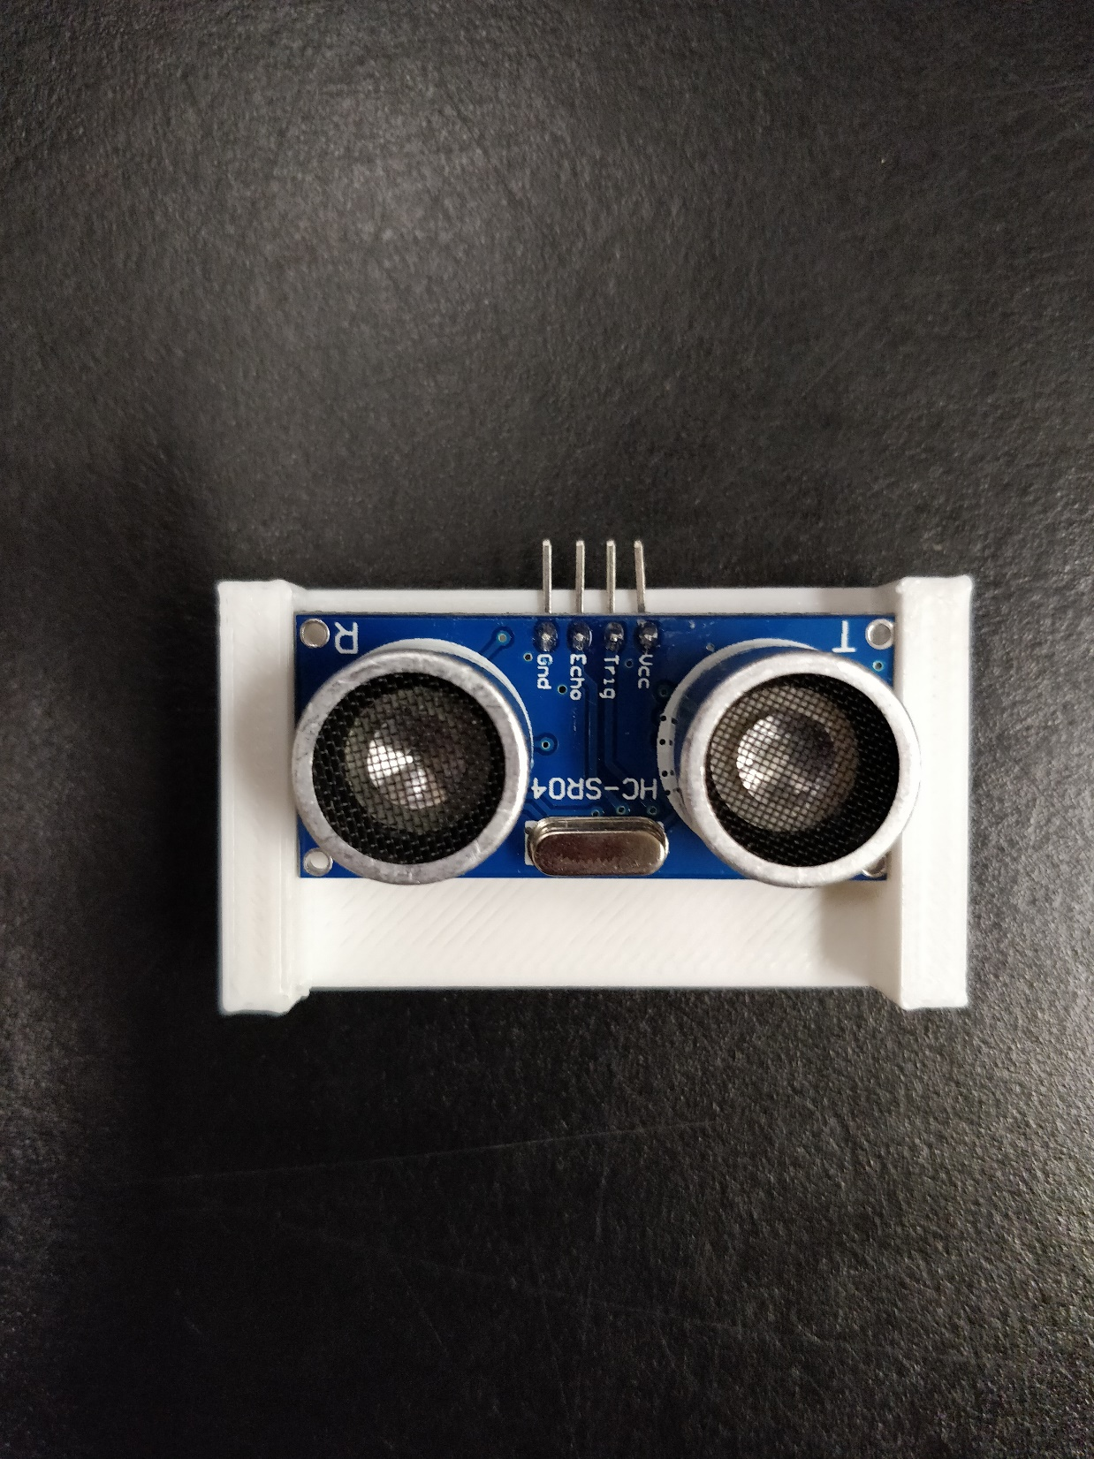
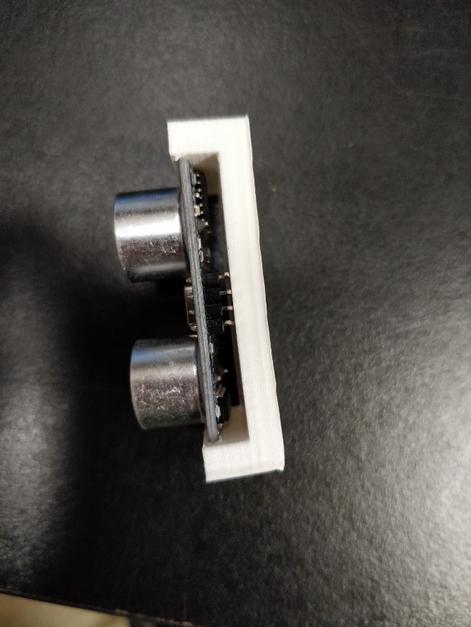
Bad Luck to have a boat/ship without a name

Slide 30
To design a control system for an Autonomous boat that can navigate through the test track while performing the following:
Adaptive Cruise Control: The boat should keep a distance of 30 cm from any obstacle in its path.
Autonomous Lane Keeping: The vehicle should be able to steer appropriately such that it stays within the track limits. (30-40 cms)

Slide 31
Differential Drive Control ?

Slide 32
Challenges
Design:
Since the Boat was not professionally designed, we had implement a number of modifications in order to get the weight balance just right.
Additionally, we had to add a bit of dead weight at the rear of the boat so that we get a low Center of Gravity which basically improves the stability of the boat. (initial design)
The Sensor positions had to be elevated due to the arrangement of the test track.
Because of the improper weight balance, we had come up with a new design which changed the control o boat

Slide 33
Hardware:
Since there were two motors it was very difficult to get them running at the same speed.
It would have been great if there was a way to measure the speeds.
Plus, the orientation of the two motors is not perfect & this further leads to the unbalanced motion which had to be corrected.
Battery:
The Motors ran at different speeds for different voltage batteries. Additionally, the performance of the motors gradually degraded as the battery discharged which basically hampered us from perfecting the calibration of the code as per the boat.
Also, initially, we had only one battery pack for both the Arduino & the Motor Controller which in turn led to the Arduino getting reset when we tested the boat because it was not receiving enough current due to the motor controller, hence our decision to go with two separate battery packs.
External Factors & Control Difficulty:
Wind, Rain & heavy waves often affected the functioning of the boat in a way such that they diverted the boat of course & the it wasn’t able to responds as quickly as required.
It was pretty difficult to accurately control the boat again due to its slow response & due to the inconsistency of the motors.

Slide 34
Boat leaking: The glue gun did not fill all the holes and hence some water was entering the boat hull. To solve this, we added another layer of glue and hot wax to seal any pours that were open (initial design)
Boat tilting due to high COG and not enough width: To solve this we added two flotation boons on the side to balance the boat in an event of extra roll.
Boat not turning: Our motors in initial design were placed close to each other due to which enough moment was not generated by the differential turn to turn the boat. Therefore, we remounted the motors to the outer most extremity of the boat sides to have maximum moment for turning.
Making boat steady at 50 cm from front and 50 cm from side: lateral drift due to inertia in water. Could have been solved using a Fin at the bottom of the boat hull.

Slide 35
Results
Autonomous boat kept a distance of …… cm from the boundary of the pool/obstacle.
Boat did not hit the obstacle in the path
Lane keeping and ACC observed.
The given track was covered in …… seconds.
Insert Video

Slide 36
Comparison
Parameter | Autonomous Car | Autonomous Boat
Design | had to only design the base for an RC car which housed the various hardware components. | we chose to design the boat from scratch which in turn led to some problems in balancing & running the boat straight. These had to be overcome with new design iterations
External Parameters | External Factors such as Wind or Terrain did not affect the functioning of this car. | External factors such as a slight wind or heavy waves caused a drastic change in the functioning of the boat.
Testing & Control | Both Position & Steering Control were relatively much easier to calibrate & test since the car readily reacted to the steering & velocity inputs. | Steering & Position Control were comparatively much more difficult to calibrate & test since the boat was much slower to respond to sudden changes in steering & velocity input.
Calibration issues due to Irregular Behavior | Calibrating the motion of the car was much simpler as we could observe repeatable results. | Calibrating the motion of the boat using simple logic was a lot more difficult because of the inconsistency in the performance of the motors as the battery discharged.
Differential Operation | Since the car consisted of just one motor, both its driving wheels had the same, consistent velocity output. | Since, the boat had to driving motors, it was pretty difficult to obtain the same consistent velocity from them which in turn led to the difficulties in getting the boat to go straight.
Observing Controller tuning | Easier to observe and test PID controller | Had to put the boat in water every time we made a small change

Slide 37
THANK YOU
Questions ?

